Slide 1

Blossoms at Backyard
Presented By:
Shivani Awatade
Sushmita Paunikar

Slide 2
Introduction
This is an informatory website that will familiarize the user with “Horticulture”. It’s front-end is created using HTML and CSS and back end is supported by PHP, My-SQL Database. People using this website will get to know a lot about gardening and cultivation of garden crops, medicinal and ornamental plants. They can also get a brief information about the popular gardening techniques like budding, landscaping, cultivation of bonsai etc. which will help them decorate their garden and grow organic fruits and vegetables by using organic methods. The user will also get to know more about types of tools and soils that are suitable for their crop and the ways to nurture them. This website will provide an opportunity for their users to share tips and tricks for others to adapt.

Slide 3
Objective
To make people aware about cultivation of various garden crops, medicinal and ornamental plants.
To encourage people to adapt the idea of “kitchen garden” so that they can get organic fruits and vegetable every day.
To share the tips and tricks among people to beautify their backyards and gardens.
To provide people a platform where they can educate others by sharing their experiences in the gardens.
To encourage people about tree plantation.

Slide 4
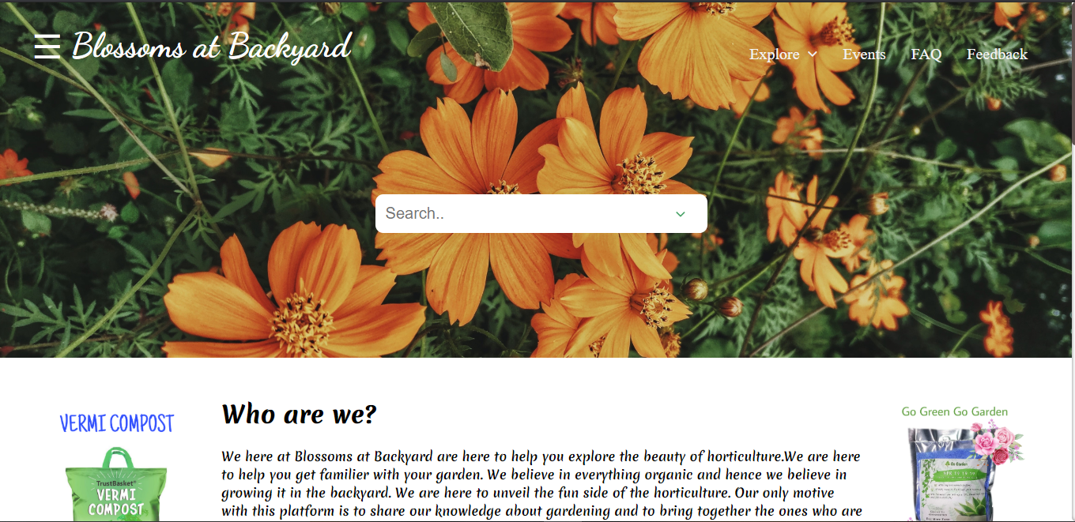
Home Page

Slide 5
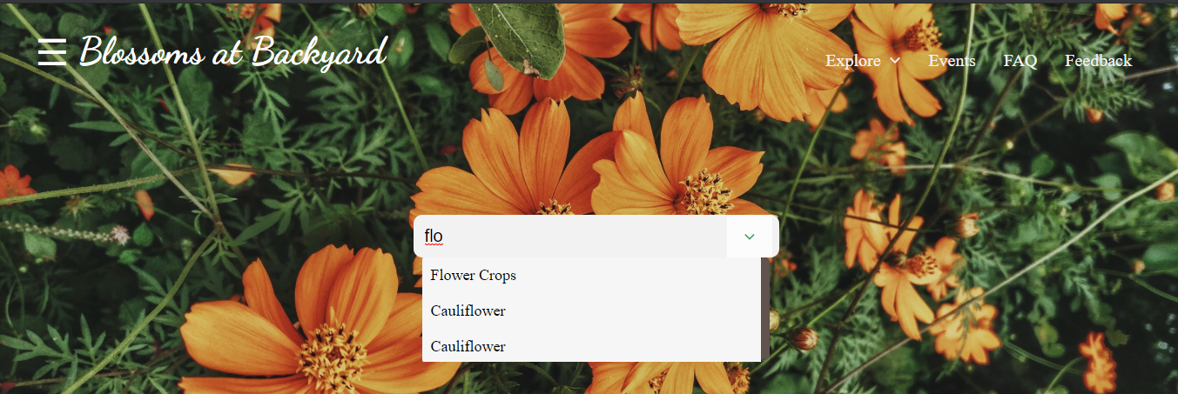
Home Page (elements)
The Search box and Top Navigation:

Slide 6
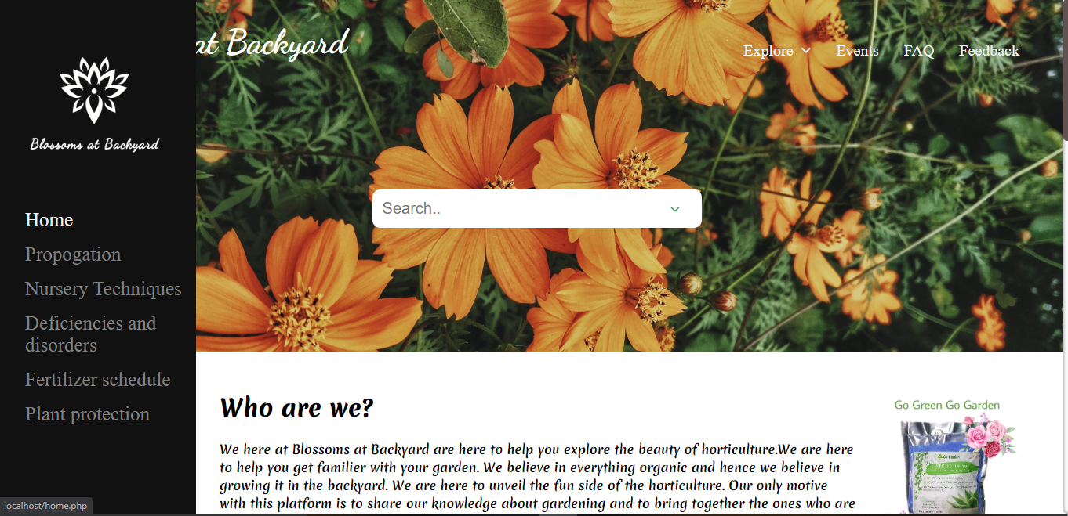
Home Page (elements)
The Side Navigation:

Slide 7
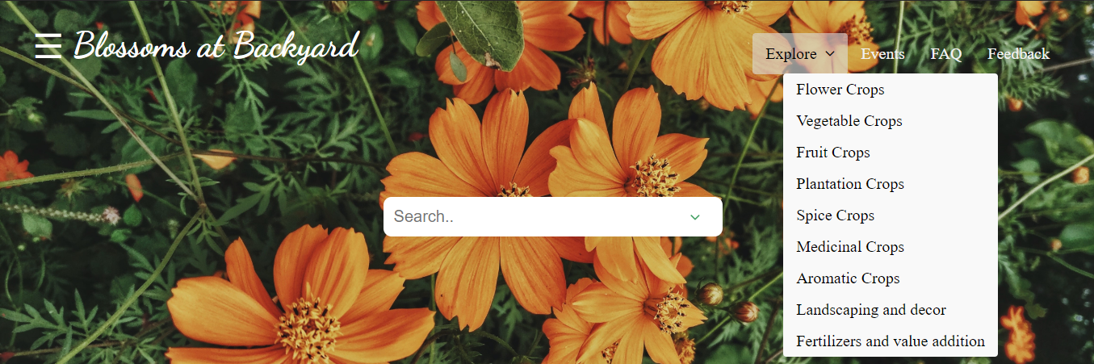
Home Page (elements)
The Explore section:

Slide 8
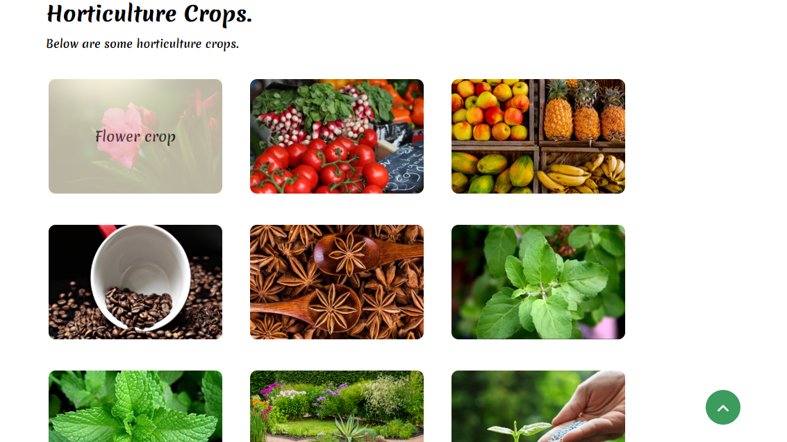
Home Page (elements)
The Explore section:

Slide 9
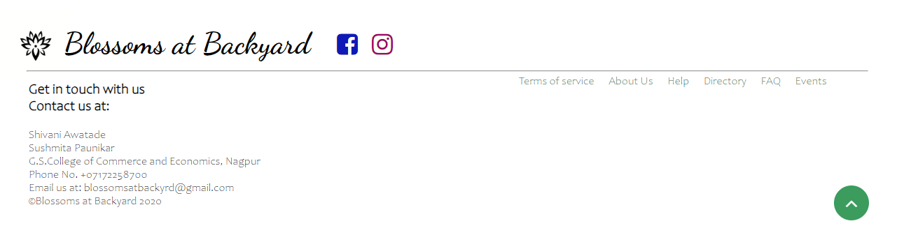
Home Page (elements)
The Footer:

Slide 10
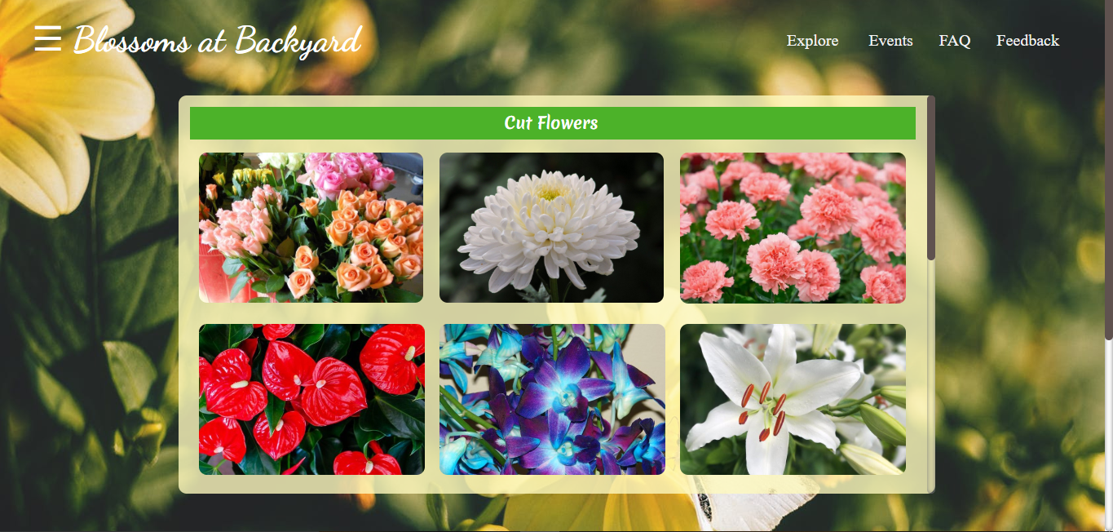
Explore Section
Flower Crops:

Slide 11
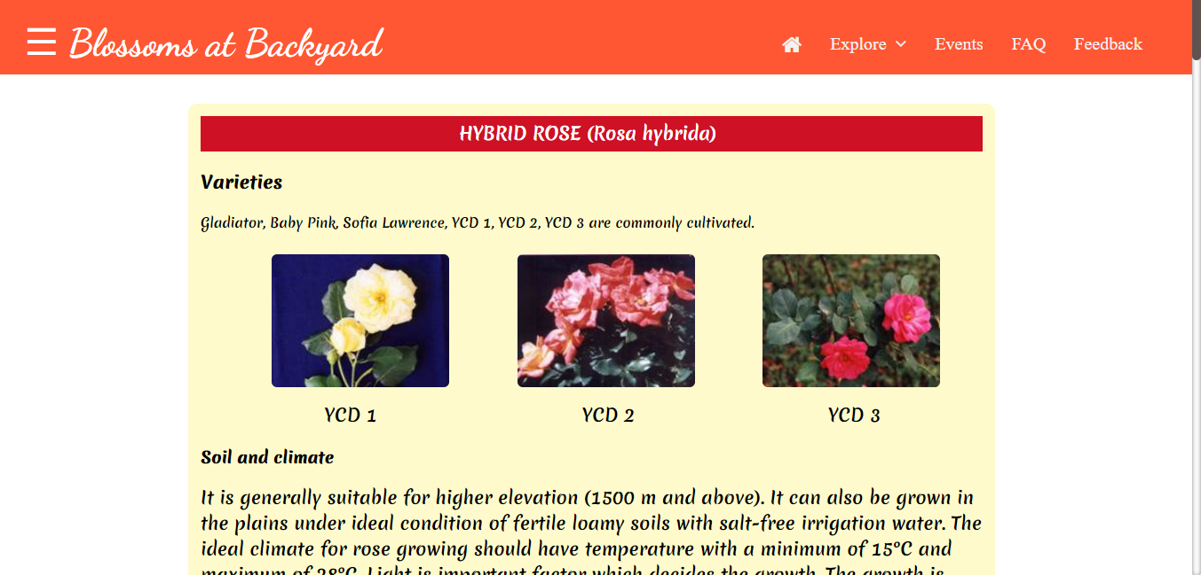
Explore Section
Flower Crops(Information):

Slide 12
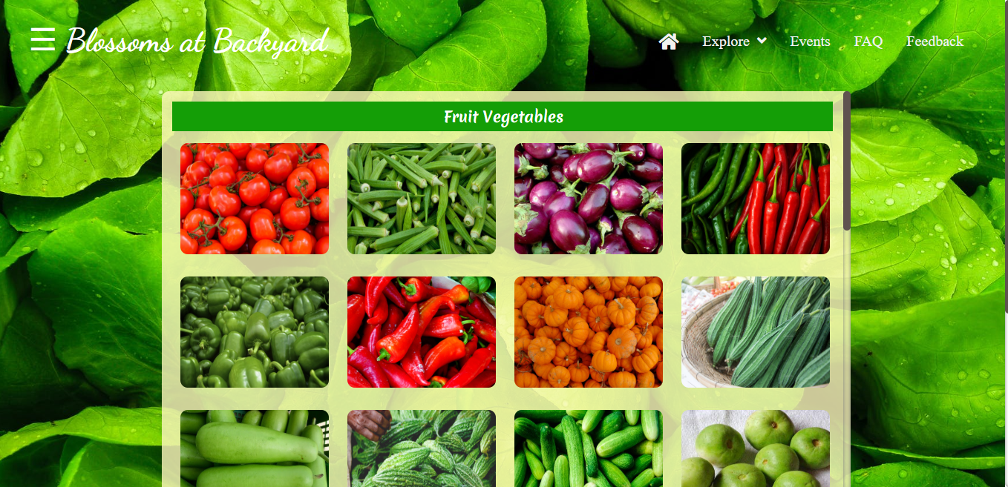
Explore Section
Vegetable Crops:

Slide 13
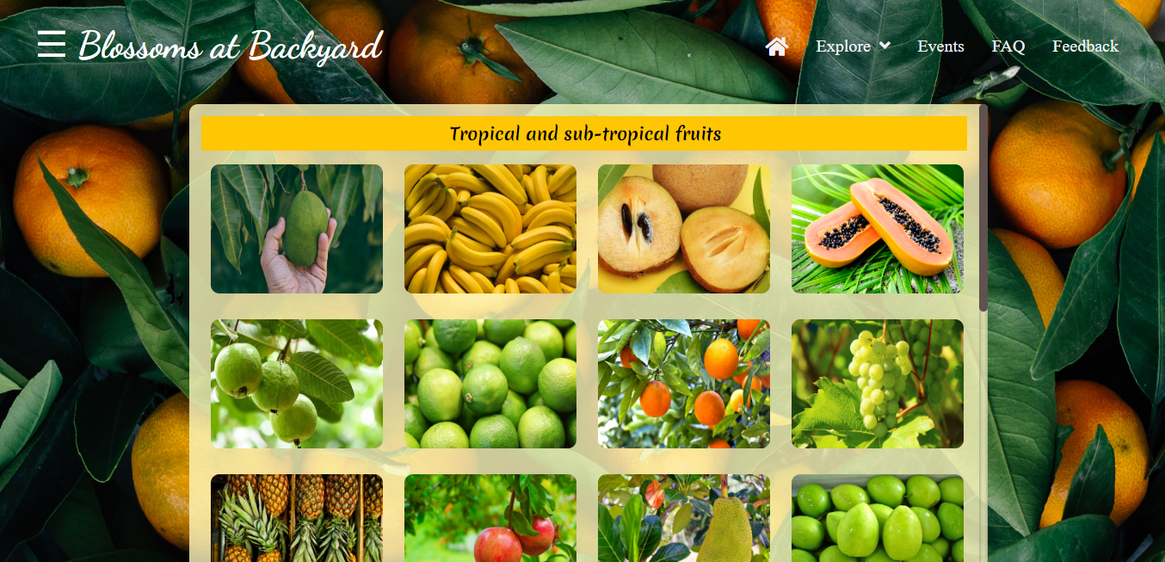
Explore Section
Fruit Crops:

Slide 14
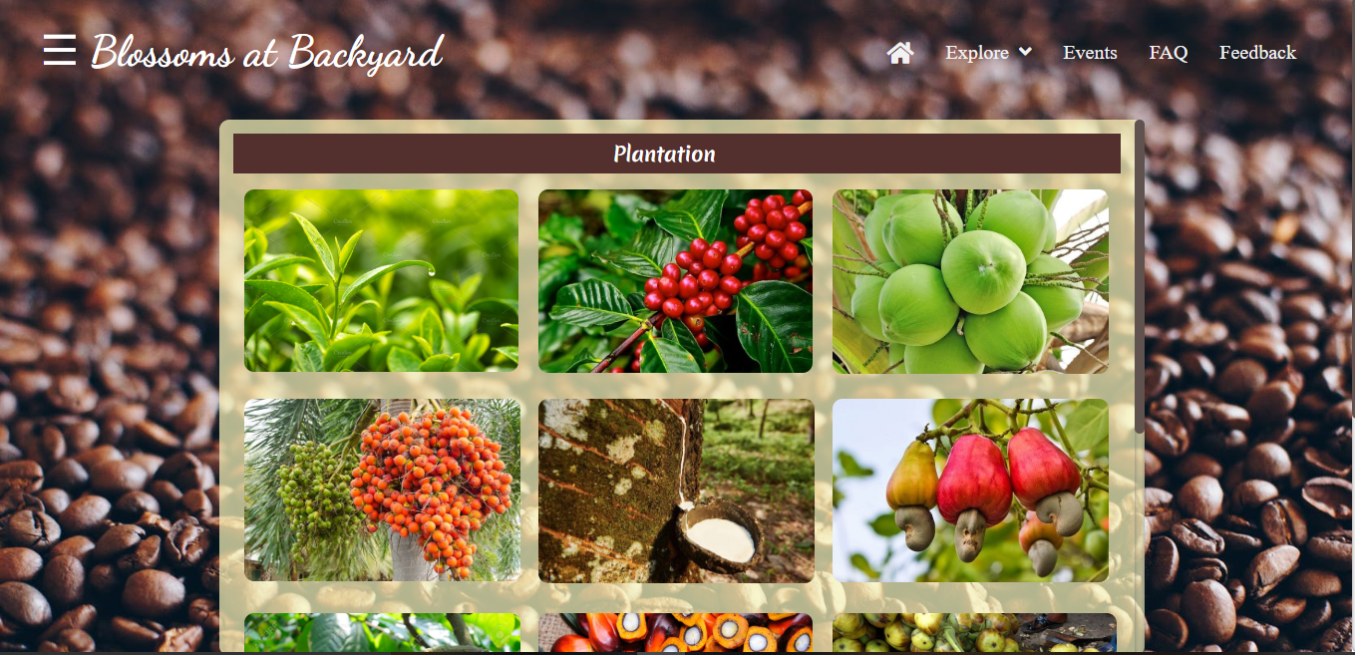
Explore Section
Plantation Crops:

Slide 15
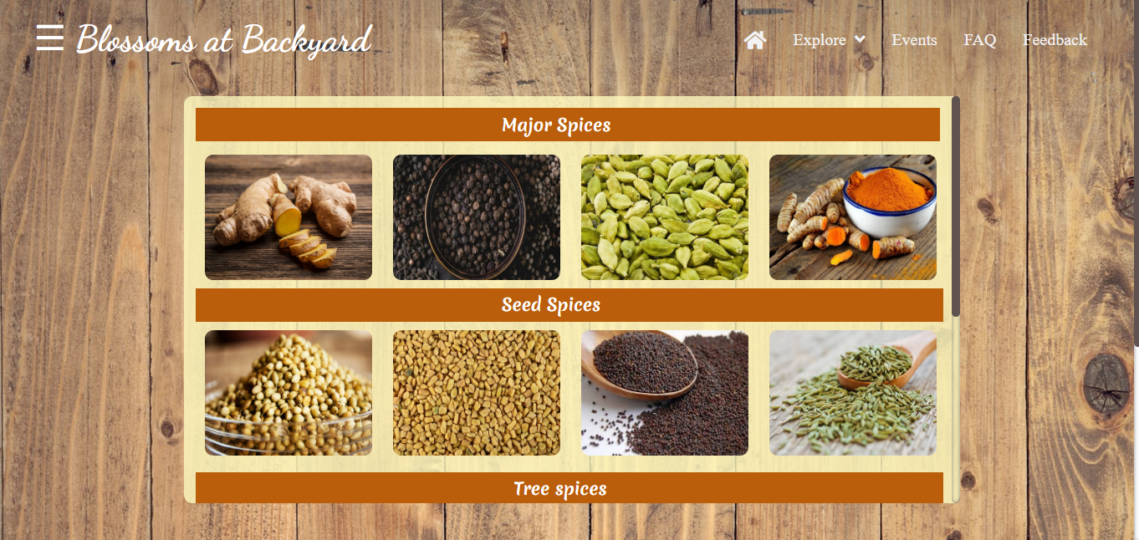
Explore Section
Spice Crops:

Slide 16
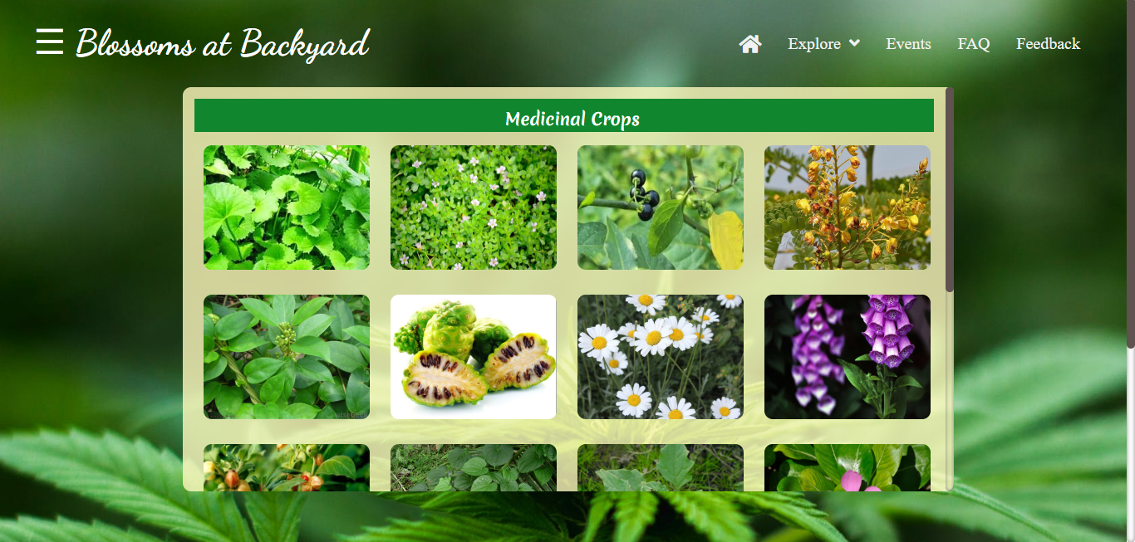
Explore Section
Medicinal Crops:

Slide 17
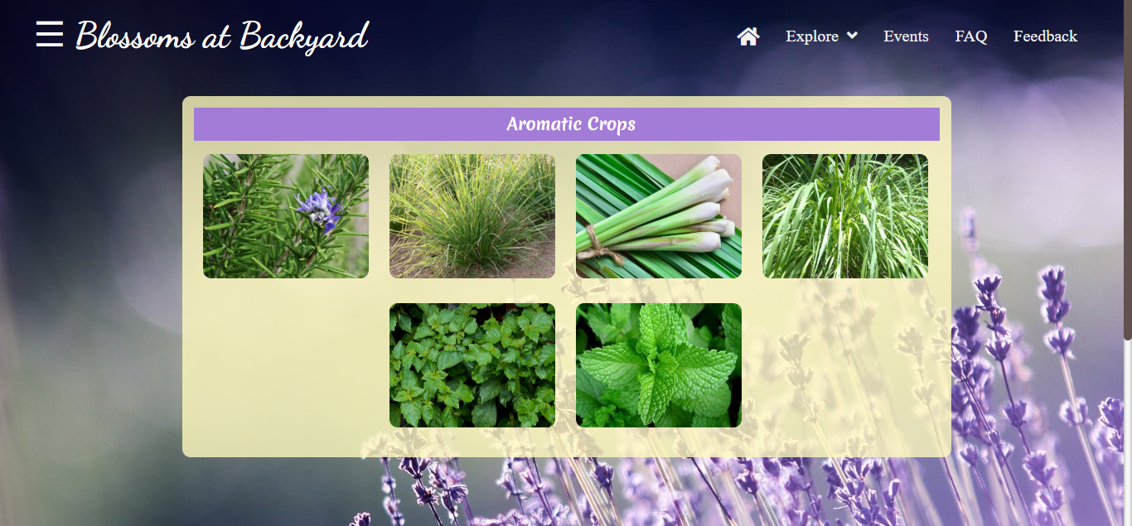
Explore Section
Aromatic Crops:

Slide 18
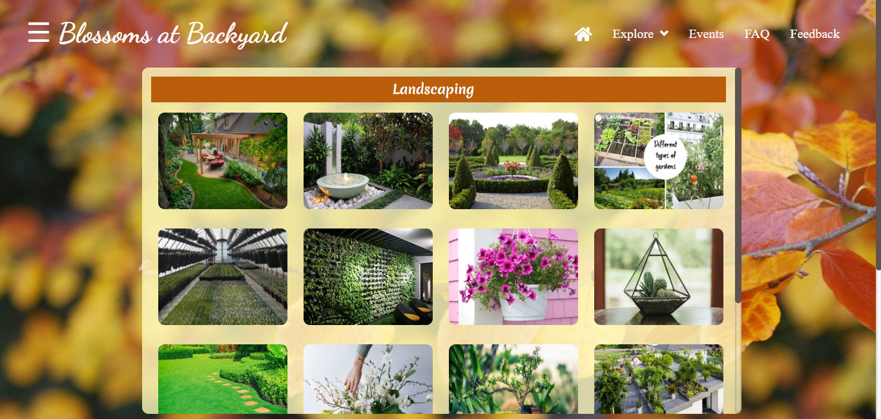
Explore Section
Landscaping:

Slide 19
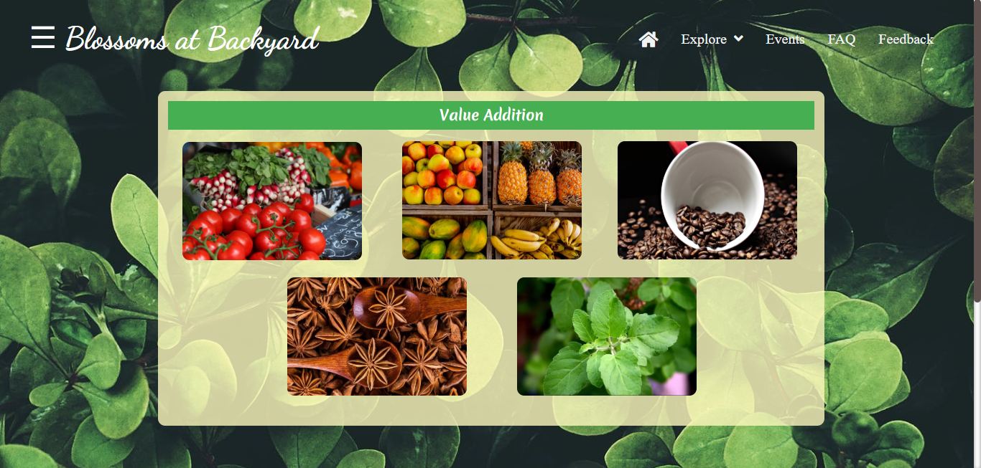
Explore Section
Value Addition and fertilizers:

Slide 20
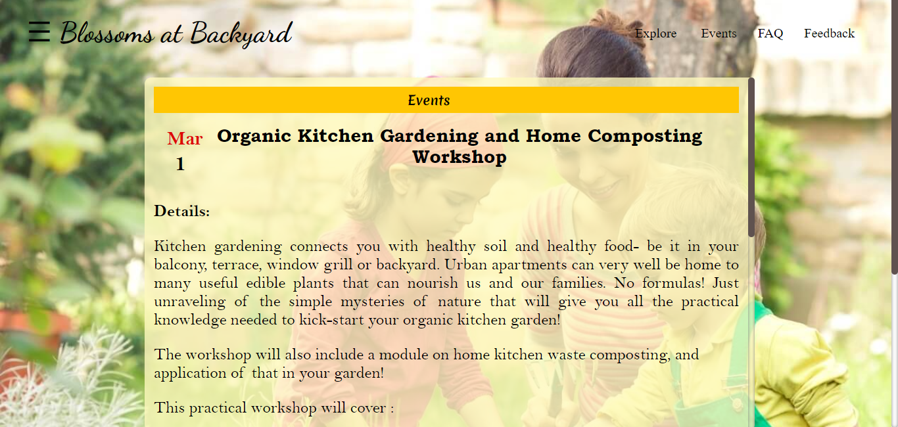
Events Section

Slide 21
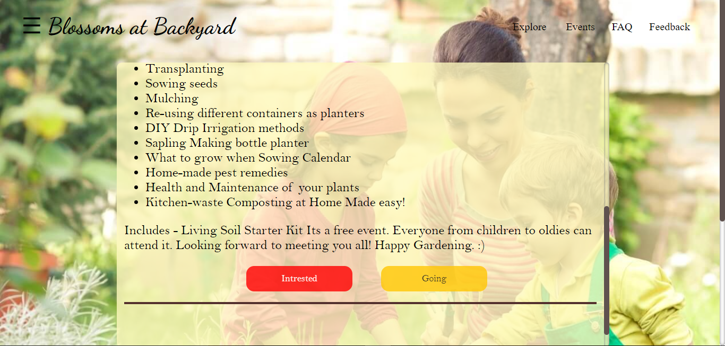
Events Section

Slide 22
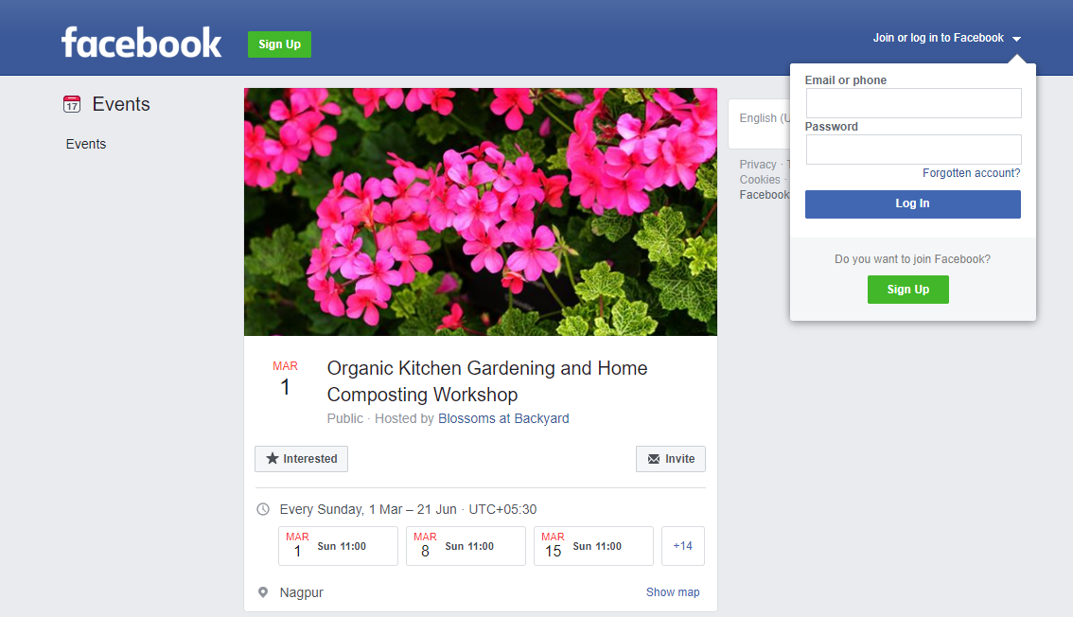
Events Section

Slide 23
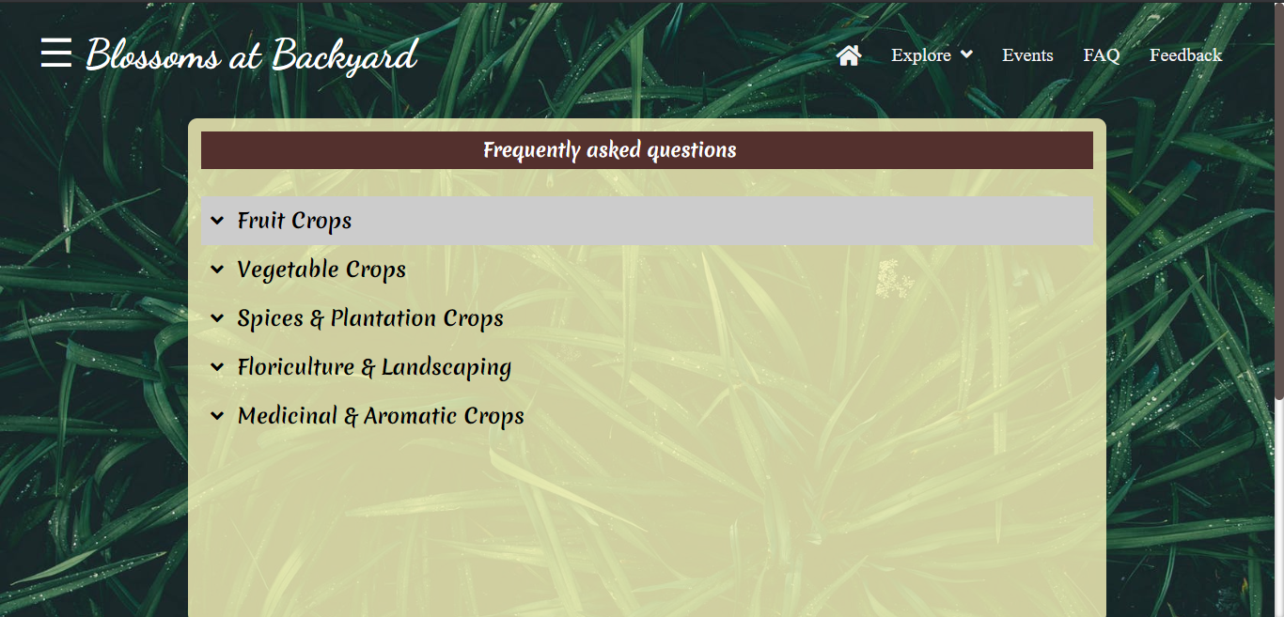
FAQ Section

Slide 24
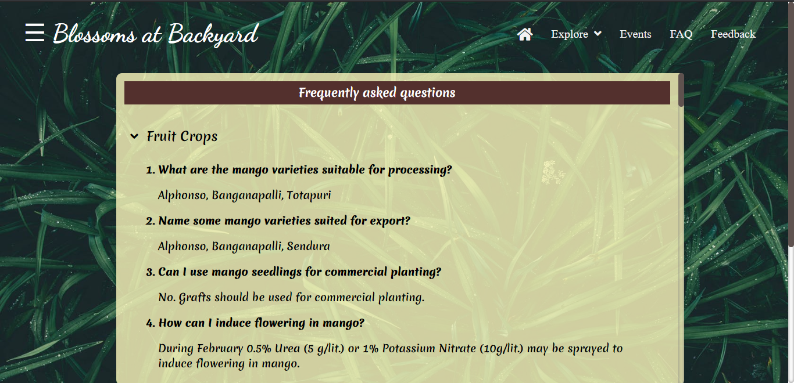
FAQ Section

Slide 25
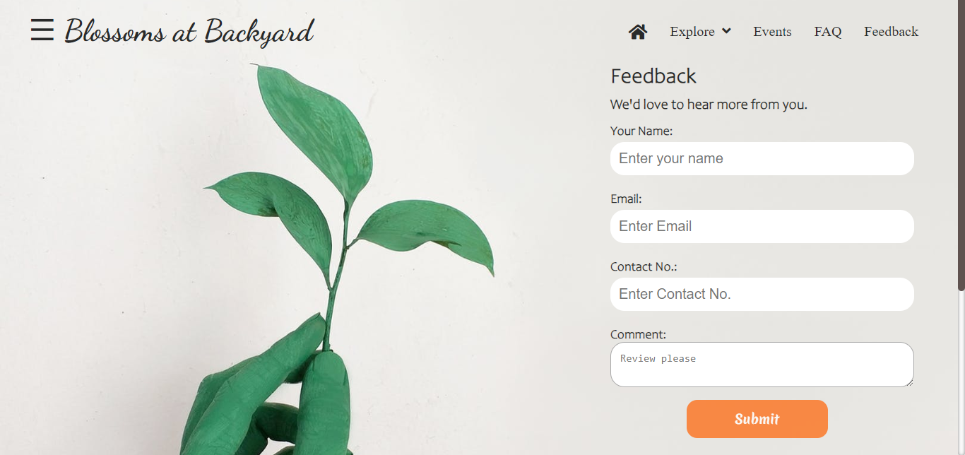
Feedback Section

Slide 26
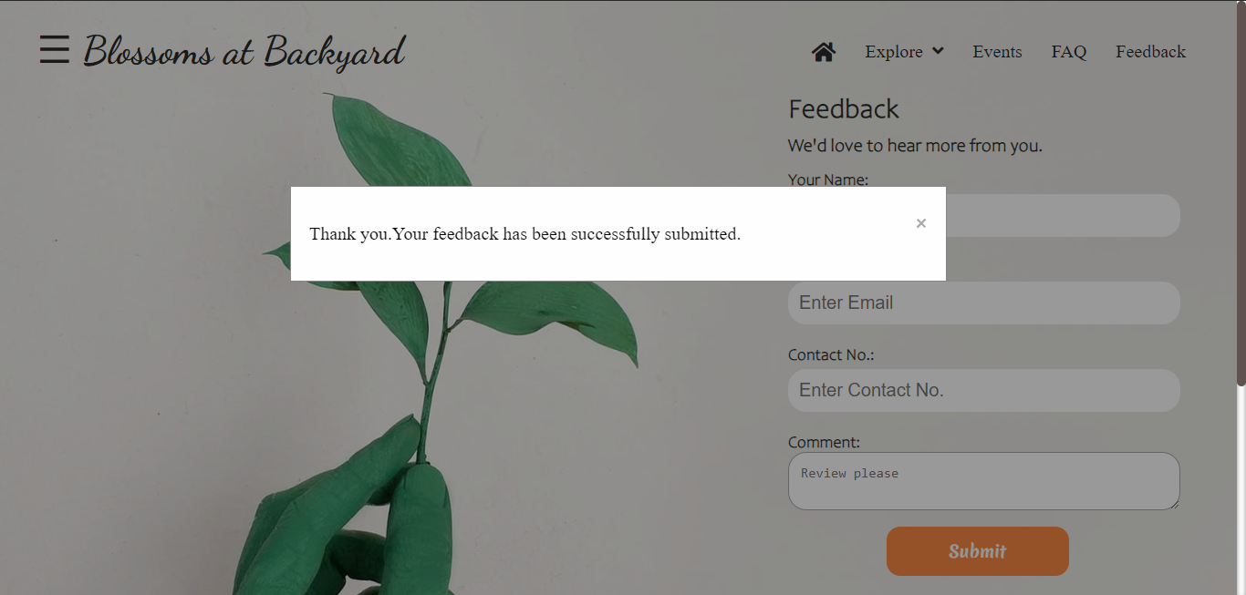
Feedback Section

Slide 27
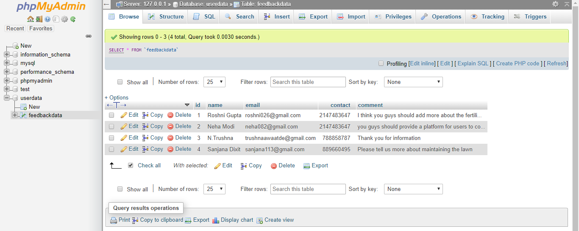
Feedback Section(database)

Slide 28
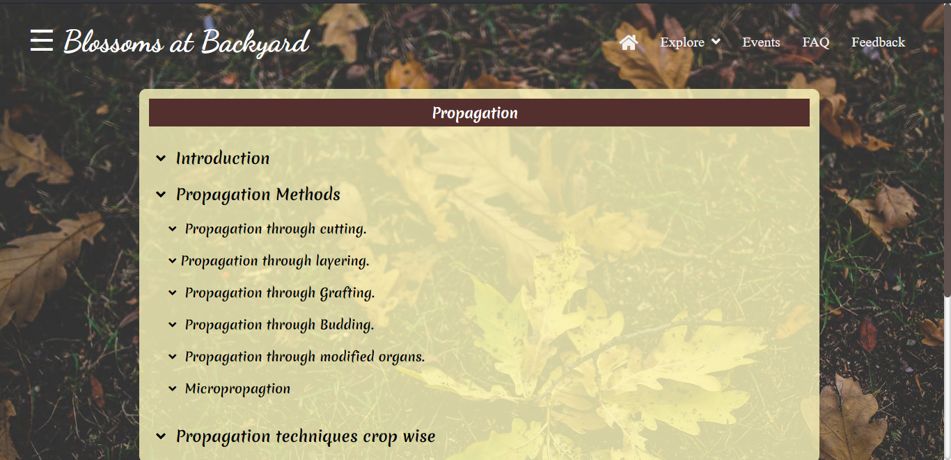
Side Navigation(Propagation)

Slide 29
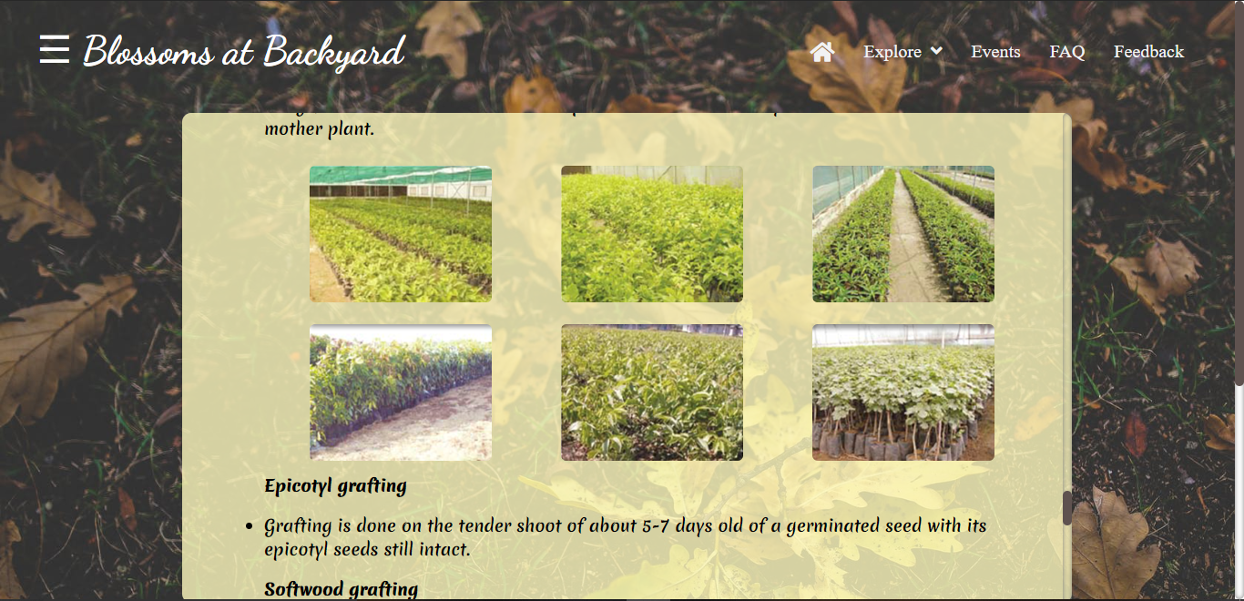
Side Navigation(Propagation)

Slide 30
Future Scope:
A. People will get aware about ways using which they can develop a healthy and beautiful garden and backyards for themselves.
B. It will make people look after their gardens minutely by recording its everyday progress.
C. It will make user focus on the details like suitable soils, fertilizers and will illustrate ways to make their own fertilizers by recycling their kitchen wastes.
D. It will help people know more about budget-friendly ways to decorate their gardens without using harmful chemical fertilizers.
E. It will encourage the idea of tree plantation among people.

Slide 31
Conclusion
Here we conclude that, This website can be used for exploring “Horticulture” and everything else that is used for developing a garden at home. With the help of this website people can connect themselves more to with their gardens and can look forward for a healthy life.

Slide 32
Thank You

